Slide 1


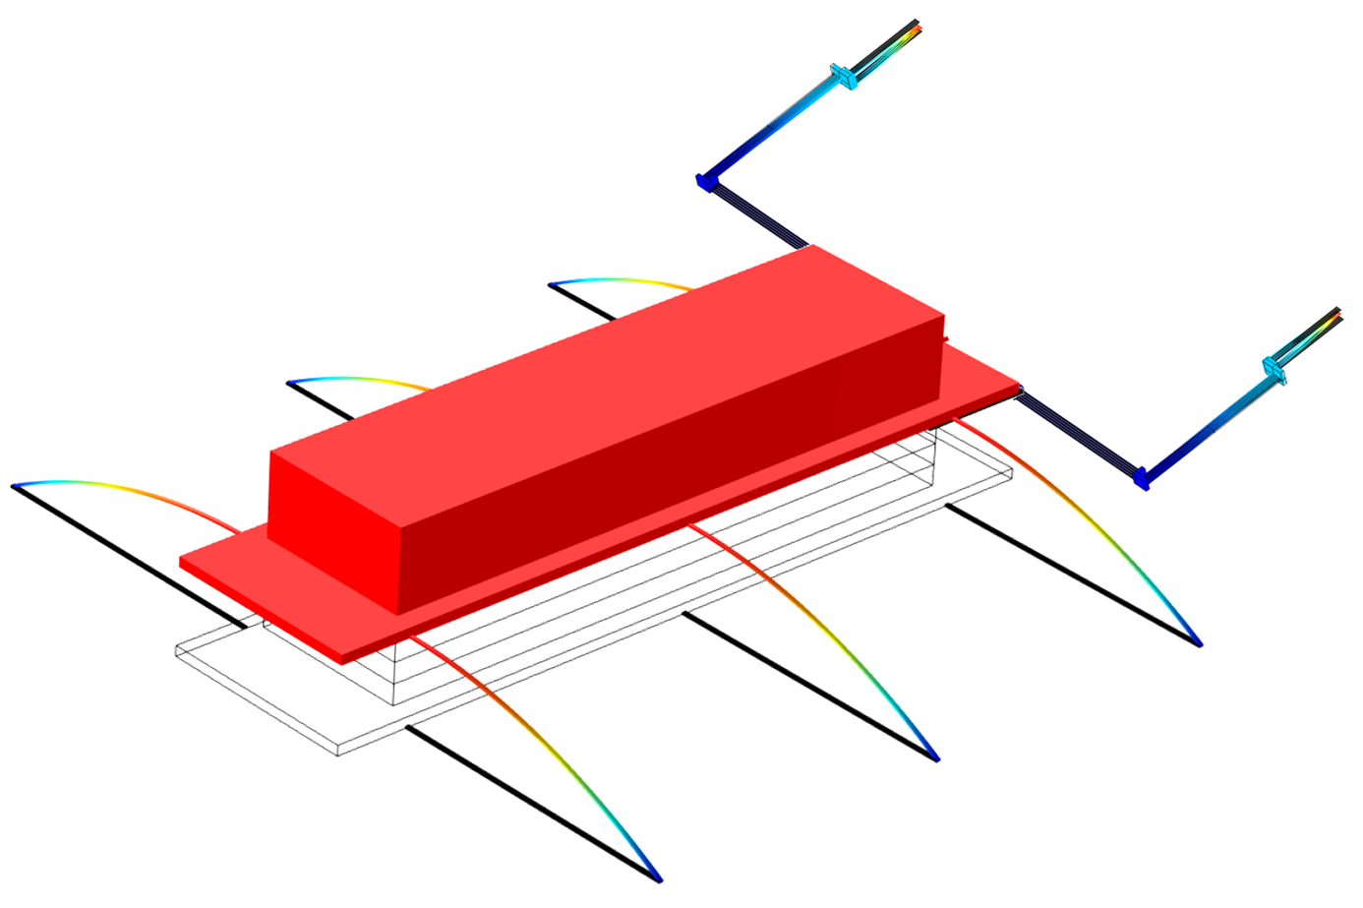
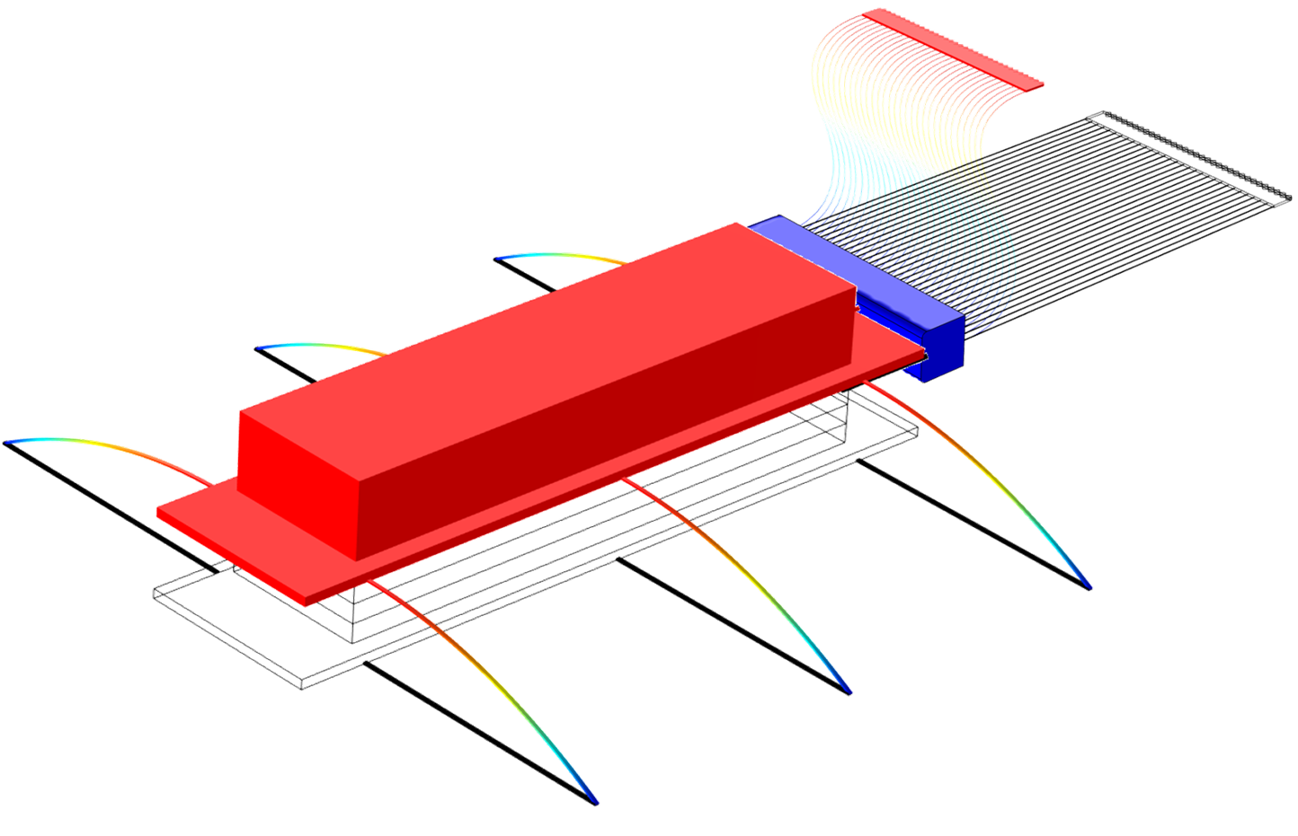
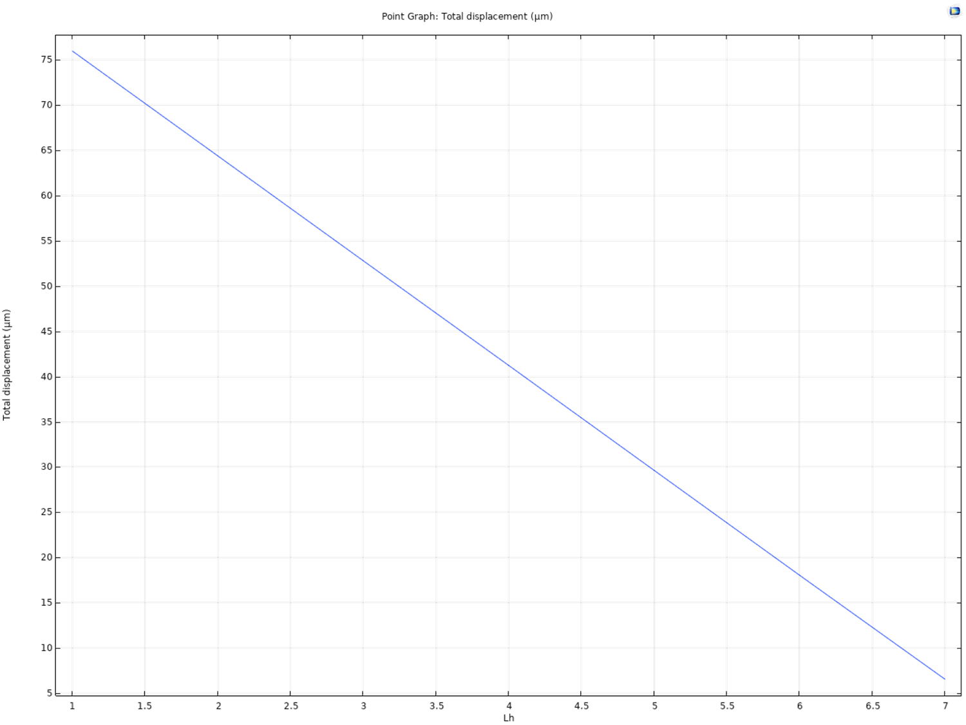
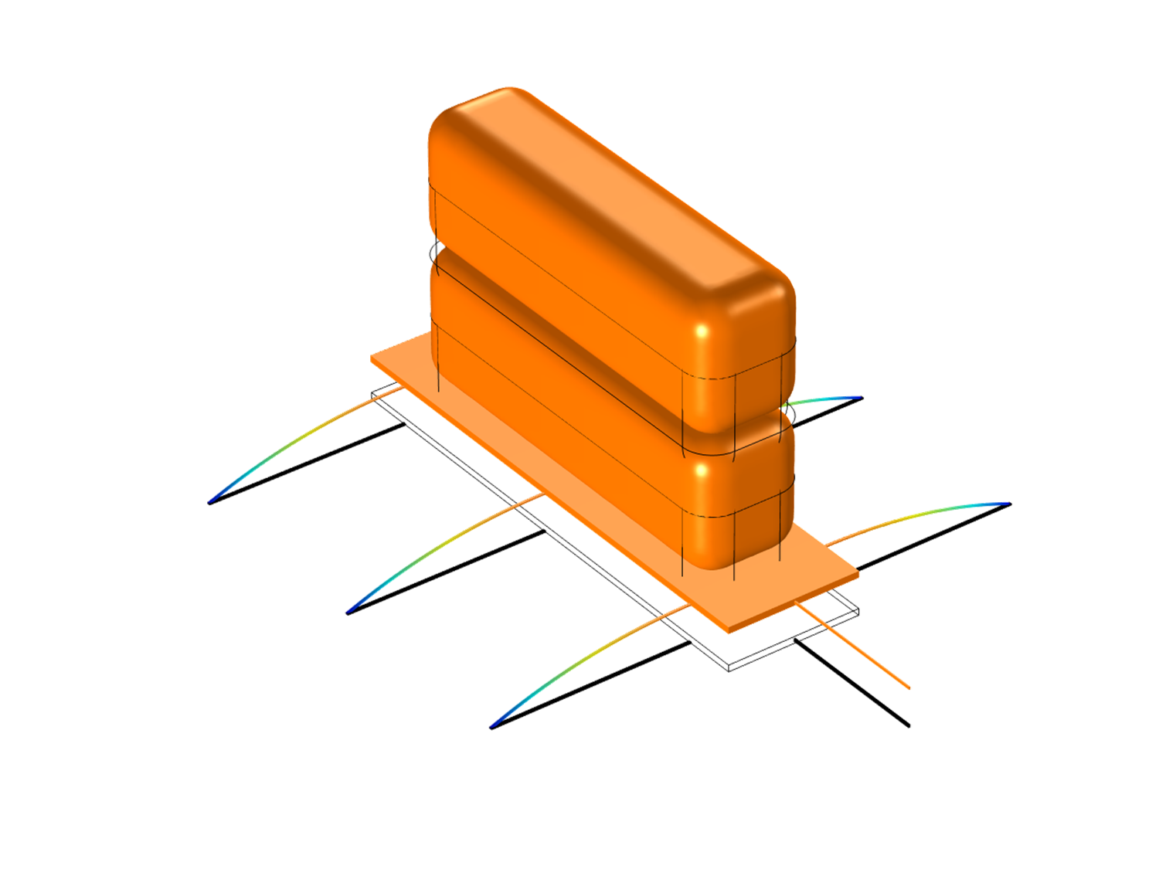
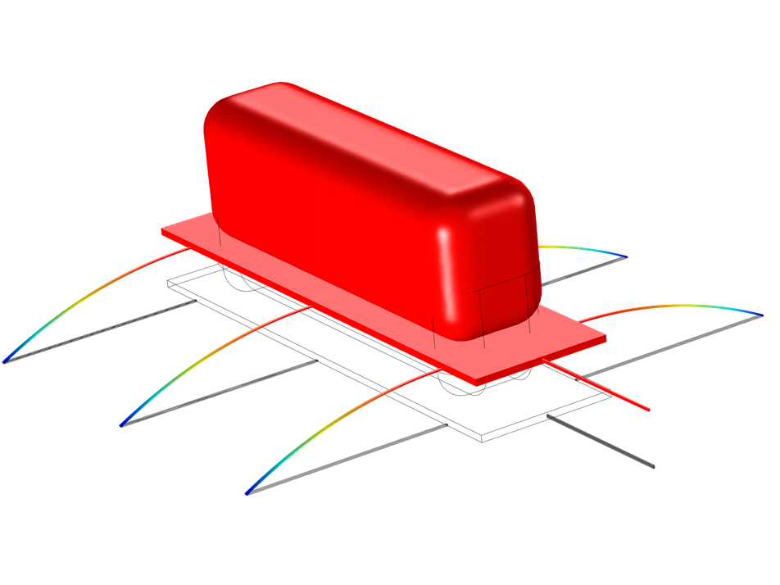
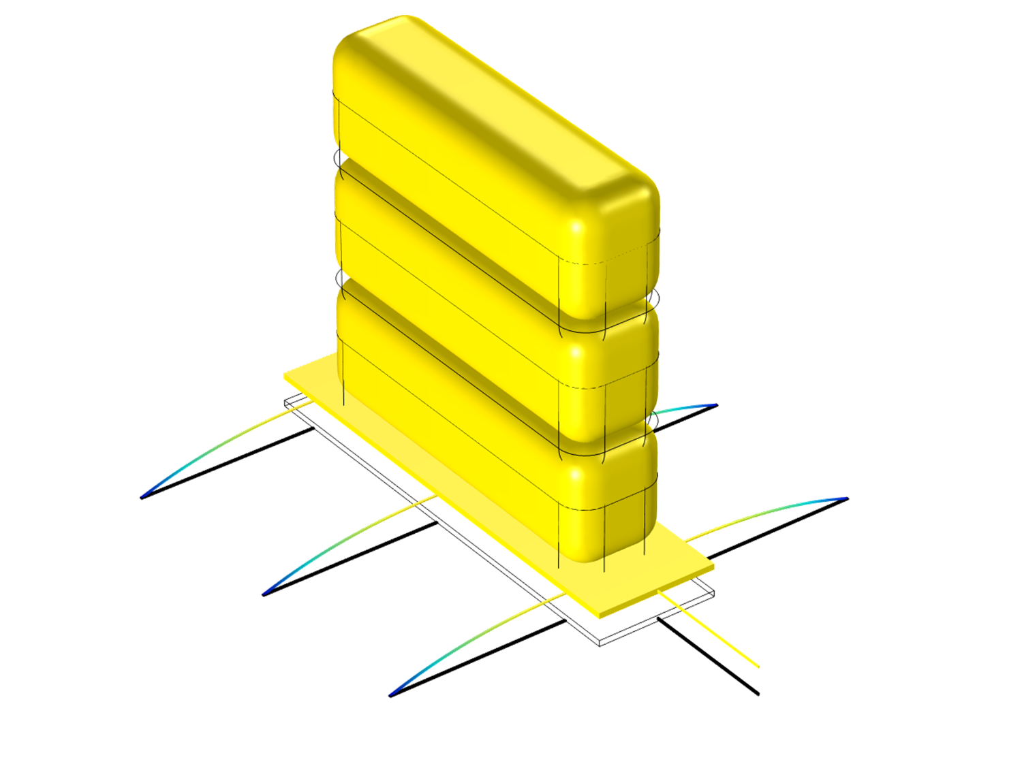
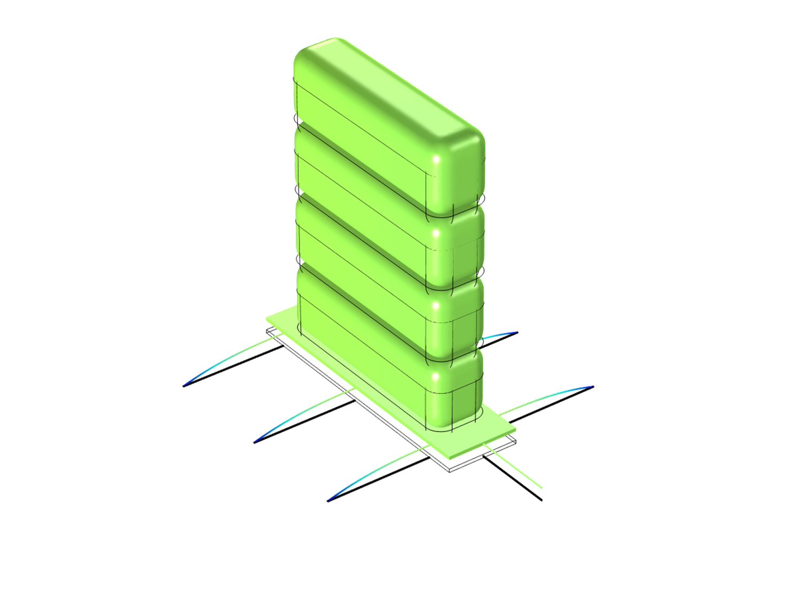
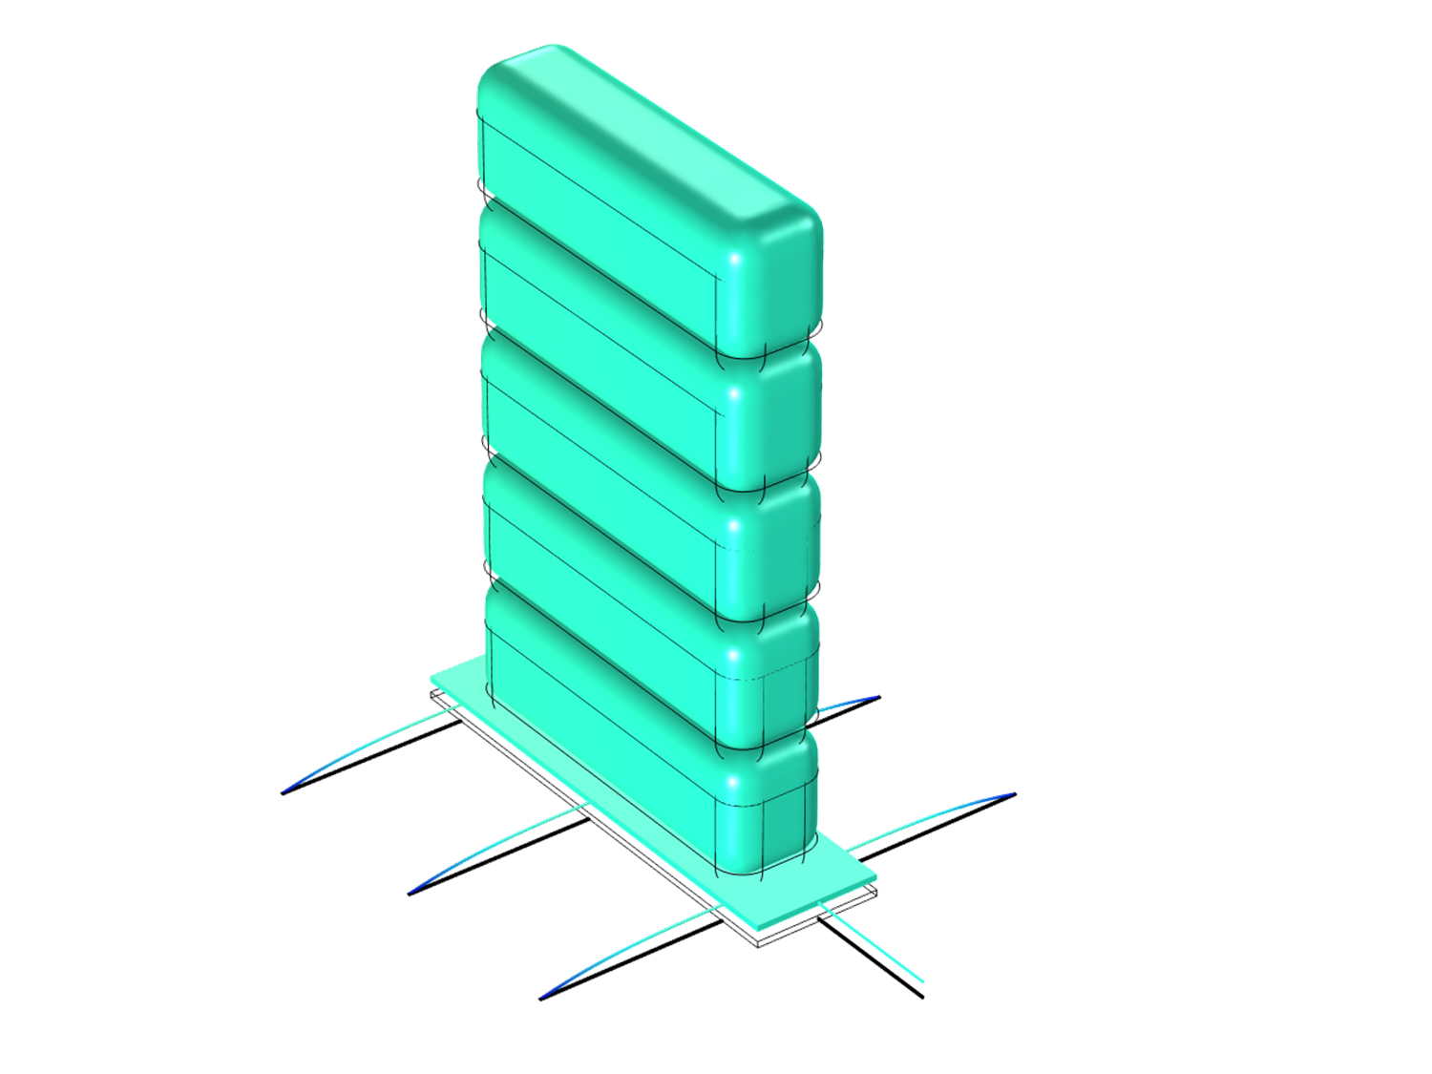
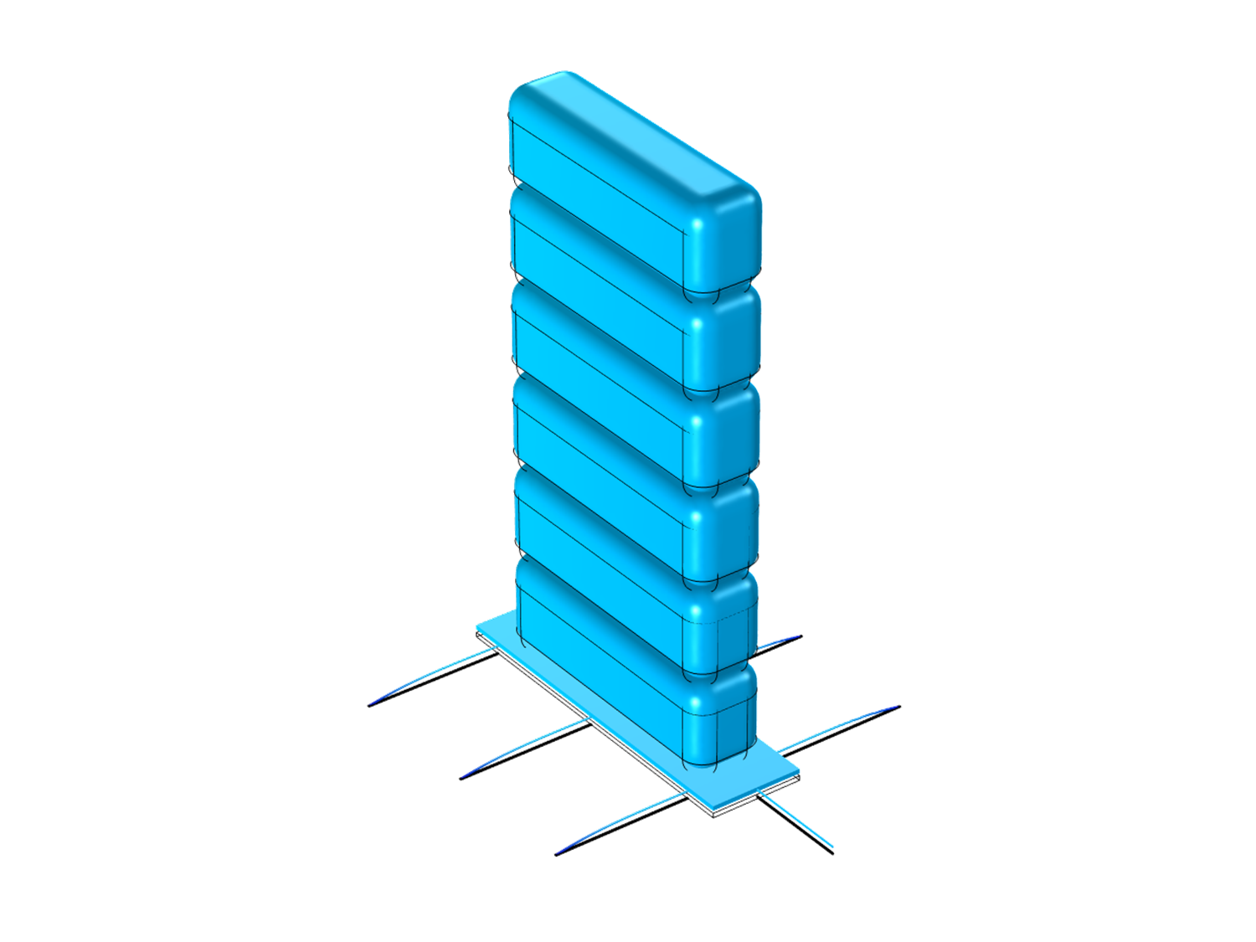
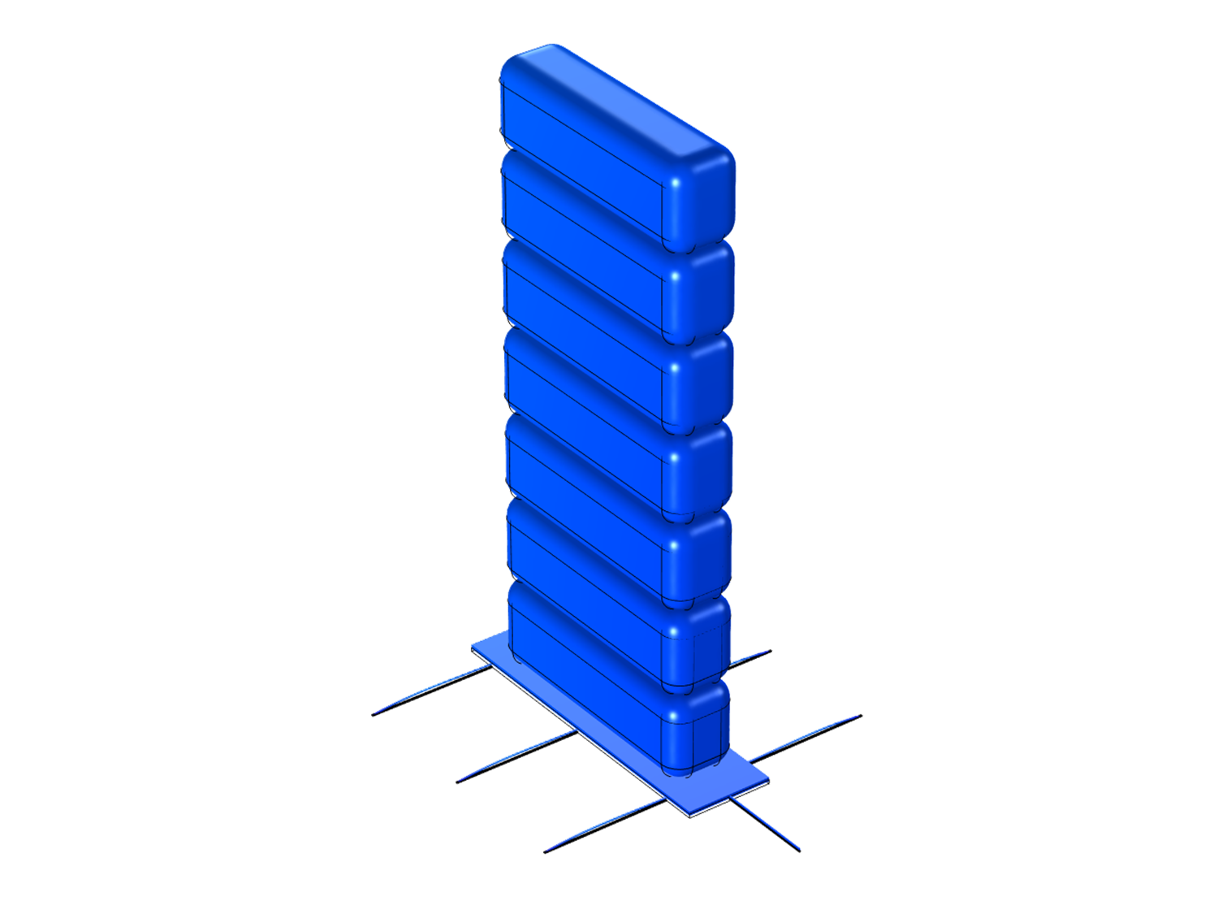
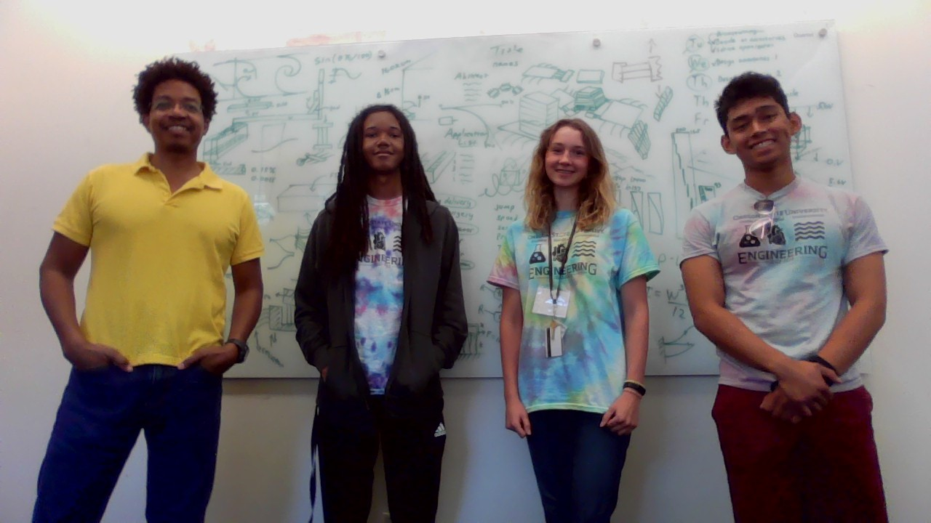
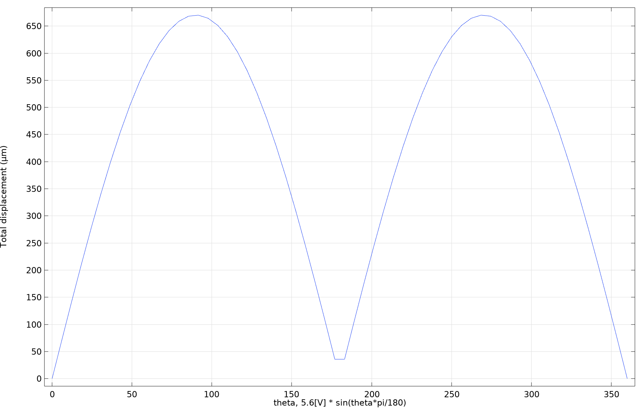
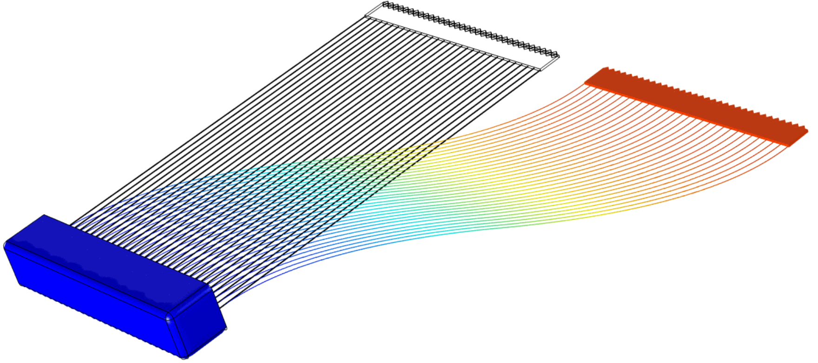
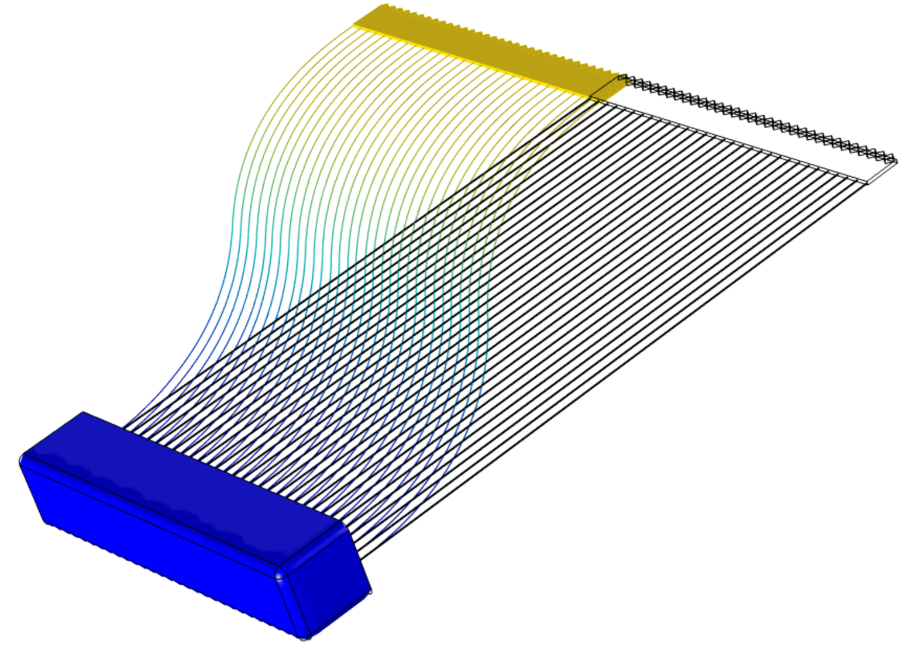
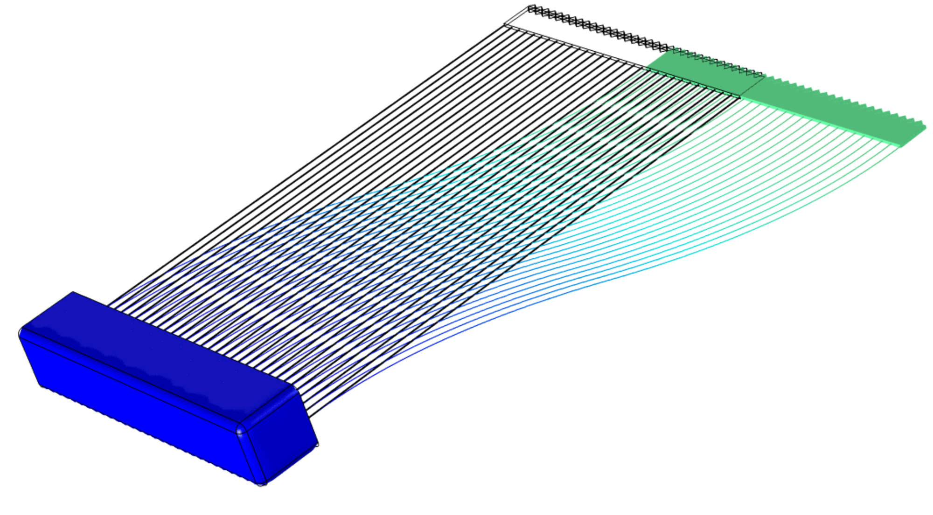
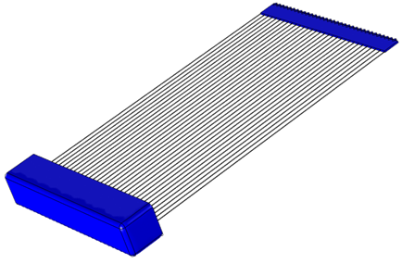
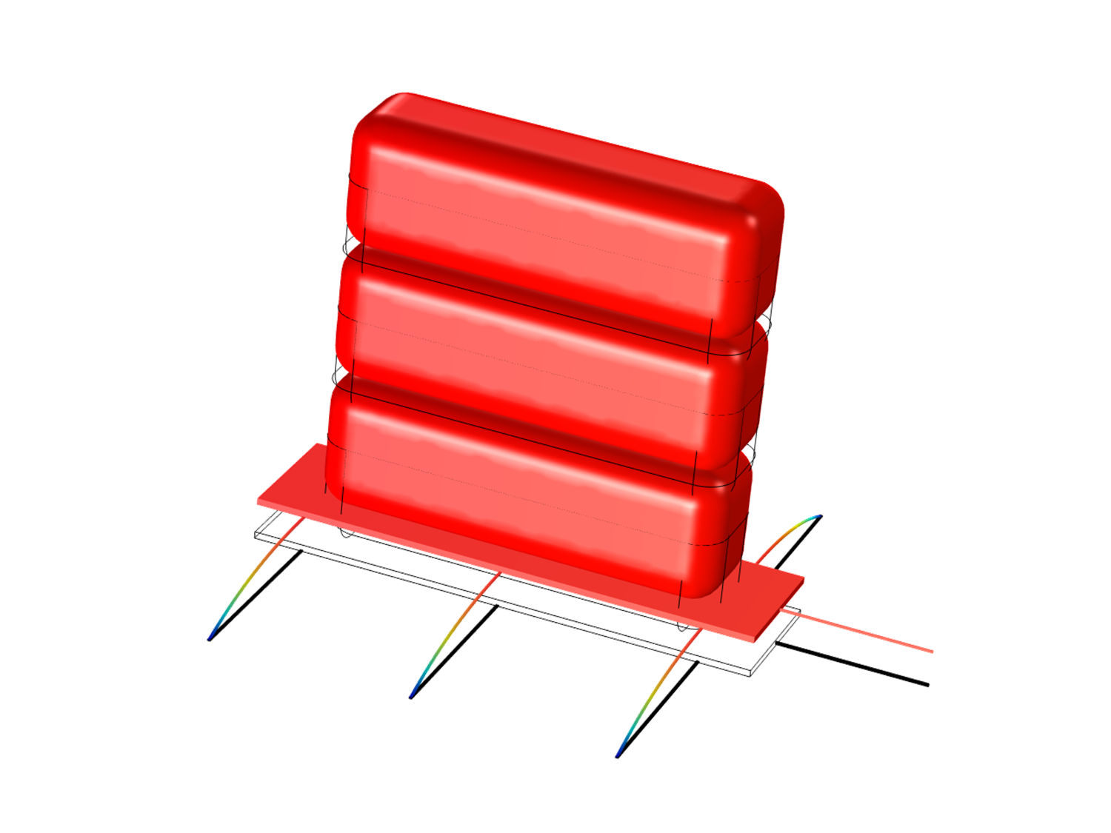
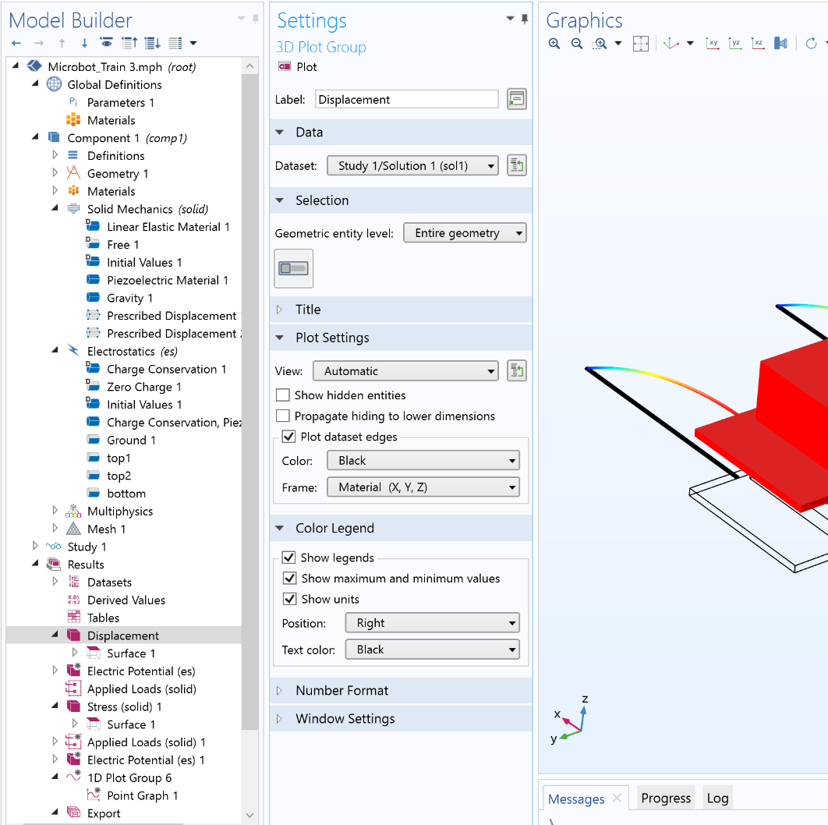
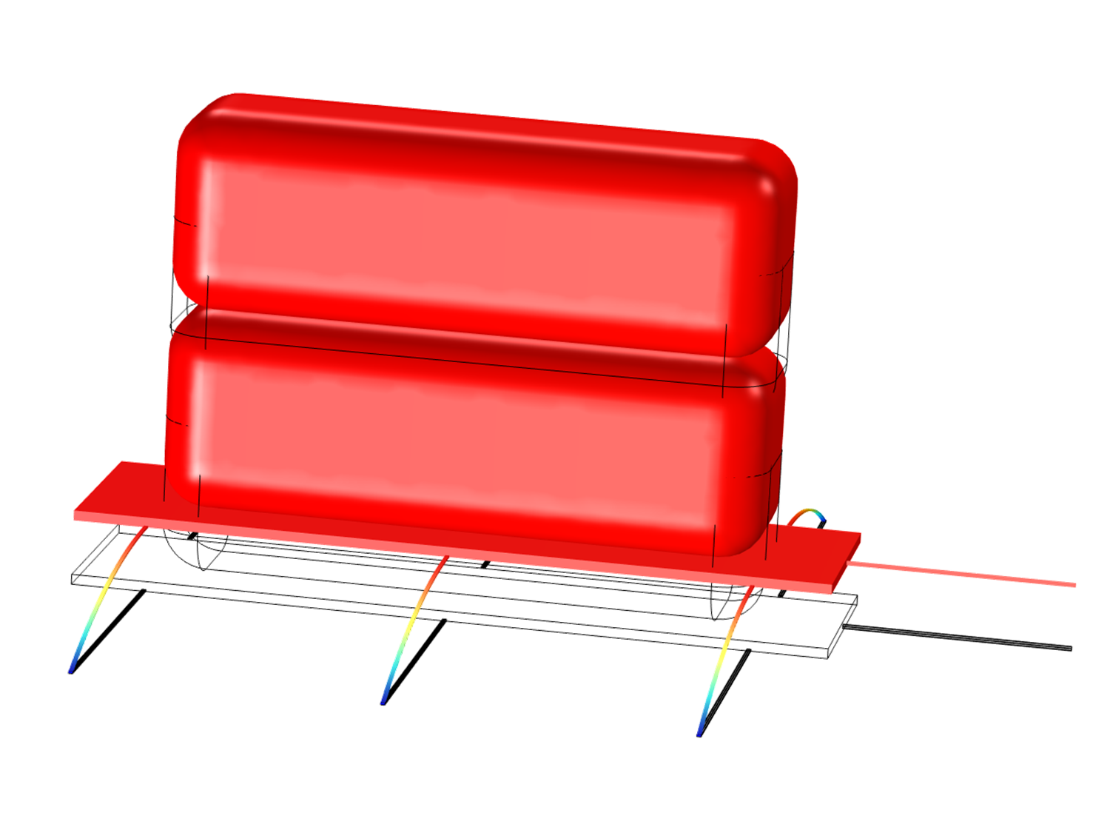
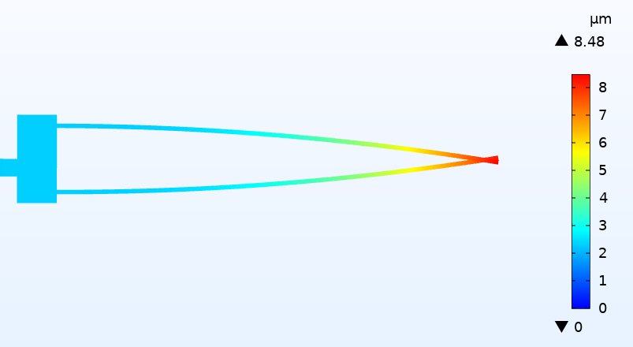
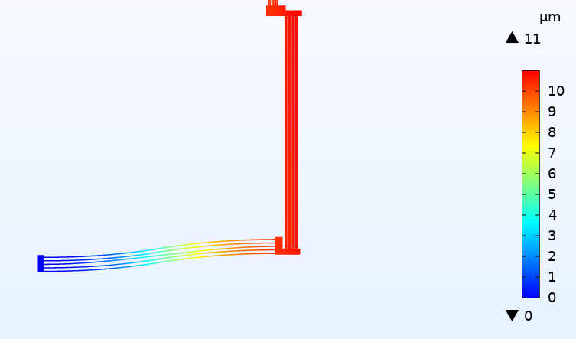
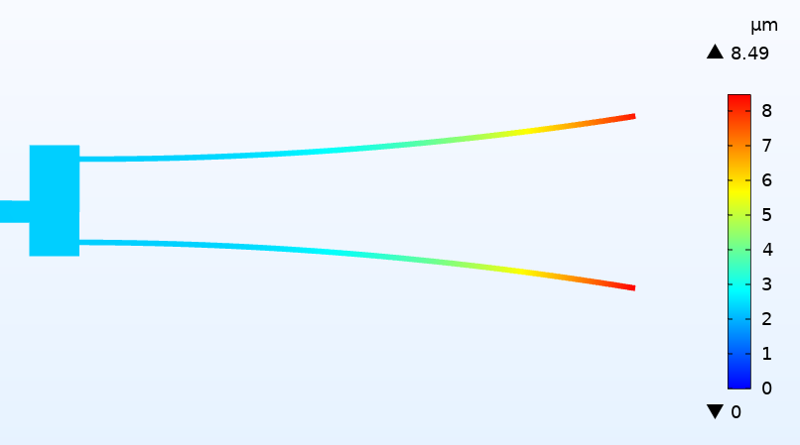
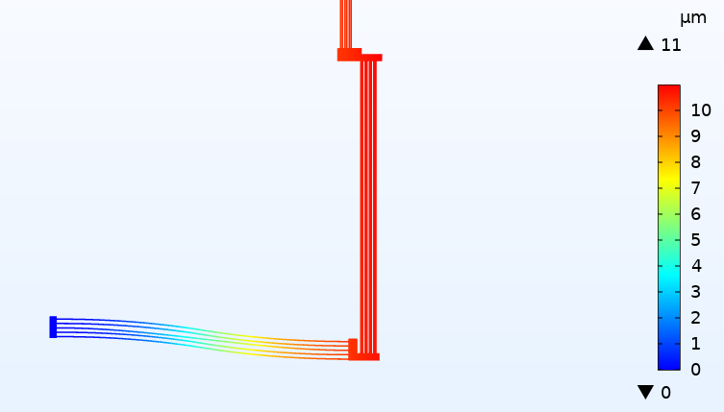
Microrobots: Design Modeling and Simulation
Nial Donohoo, Amiri Horn, Rafael Rodriguez, and Prof. Jason Clark
Introduction
Goals
Applications
In the past, roboticists chose not to use piezoelectricity for robotics because it produced too small of a deflection to be useful (i.e. 1/1000 of its length).
However, due to the advent of our s-drive, we have shown that it is possible to produce very large deflections using piezoelectricity. Moreover, the s-drive is the only actuator that can be connected to others to magnify deflection and force like the biological muscle cell. And s-drives work in reverse to harvest energy.
S-drives can also be used to create the following:
Diodes
Transistors
Logic gates
Fluidic pump
Logic gate
Operational amplifiers
Etc.
Definitions:
S-drives = A manufacturable artificial muscle cell.
Piezo = An active material which produces a voltage when pressure is applied, or produces a deflection when a voltage is applied.
In order to convert the smallest deflection actuator to the largest deflection actuator, we create a double-bimorph design, where a straight cantilever actuates into an “S” shape. Using the s-drive, we are able to design fast and dexterous solid-state robots without the usual gears, motors, pulleys, stepper motors, belt drives, servos, and other parts that wear out.
Cutter accessory
Claw
accessory
CPU
Batt.
Batt.
CPU
Results
Previously, the piezoelectric mechanism has been popular in many modern day appliances including diesel fuel, injectors, cell phones, grill igniters, acoustic guitar pickups, and vibration sensors. Present research into novel piezoelectric mechanisms could result in impactful advances. This includes the future of robotics, as piezo can be applied from small to large robots, with novel applications for drug delivery, microsurgery, clot location, heart sensory, IMU tracking, velcro, flight, medical casts, search and rescue, touch and pressure sensing, load transportation, micro manipulation, aerating, and replacing pesticides. The research done by Dr. Jason Clark could lead to all of this and more, as the concept of s-drives opens a plethora of new capabilities in which piezoelectricity can be applied to.
Transporter microrobot
Load
Ground clearance of microrobot (7 to 76um)
SESEY Microbot team
Number of stacked loads (1 to 7)
Deflection over one cycle (0 to 670um)
This SESEY team is patenting their newly improved s-drive.
Our virtual laboratory
theta, 5.6[V] * sin(theta * pi / 180)
Transporter
Claw accessory for the microrobot
Method
Load
Design
Specify geometry
Physical modeling
Piezoelectricity
Electrostatic
Mechanics
Simulation
Quasistatic
Transient
Frequency response
Acknowledgements
We would like to thank Jason Clark for inviting us to his lab and introducing his research to us, along with Dr. Skip Rochefort and the SESEY program for funding and providing us with this amazing opportunity.

Slide 2
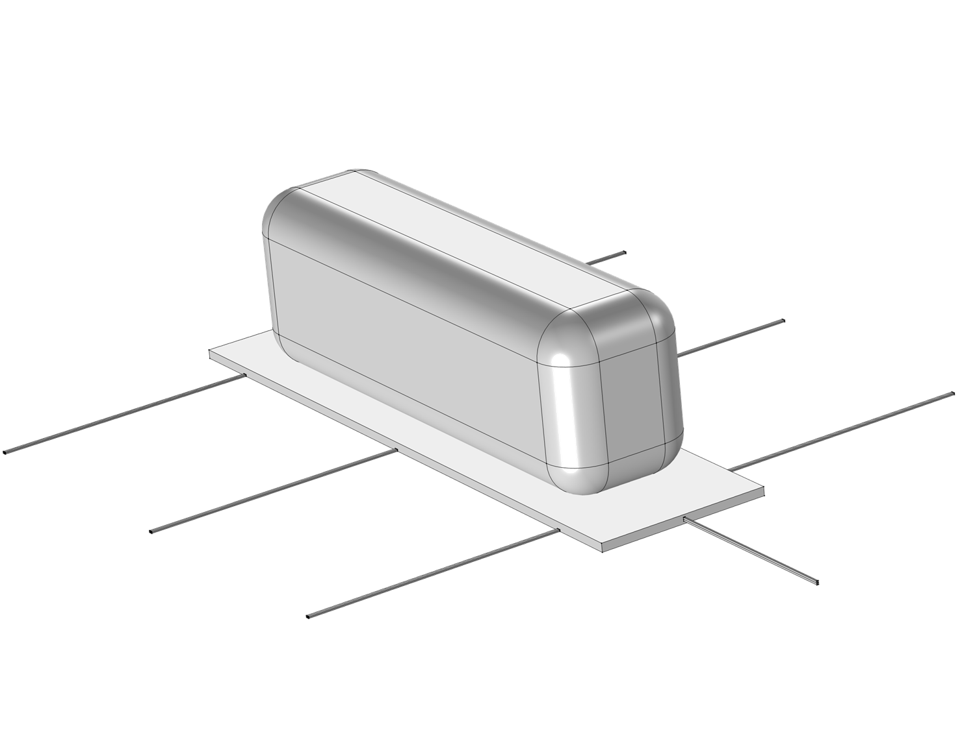

Slide 5
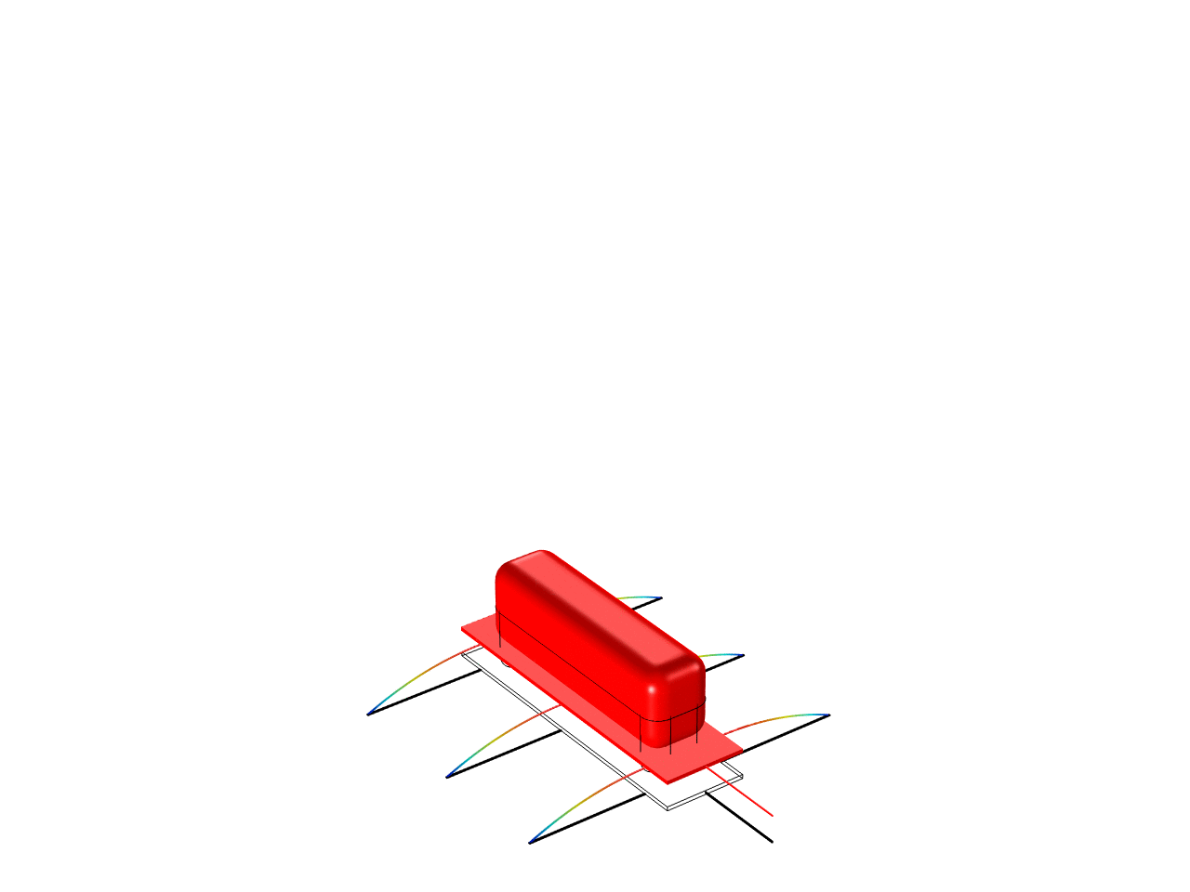

Slide 6
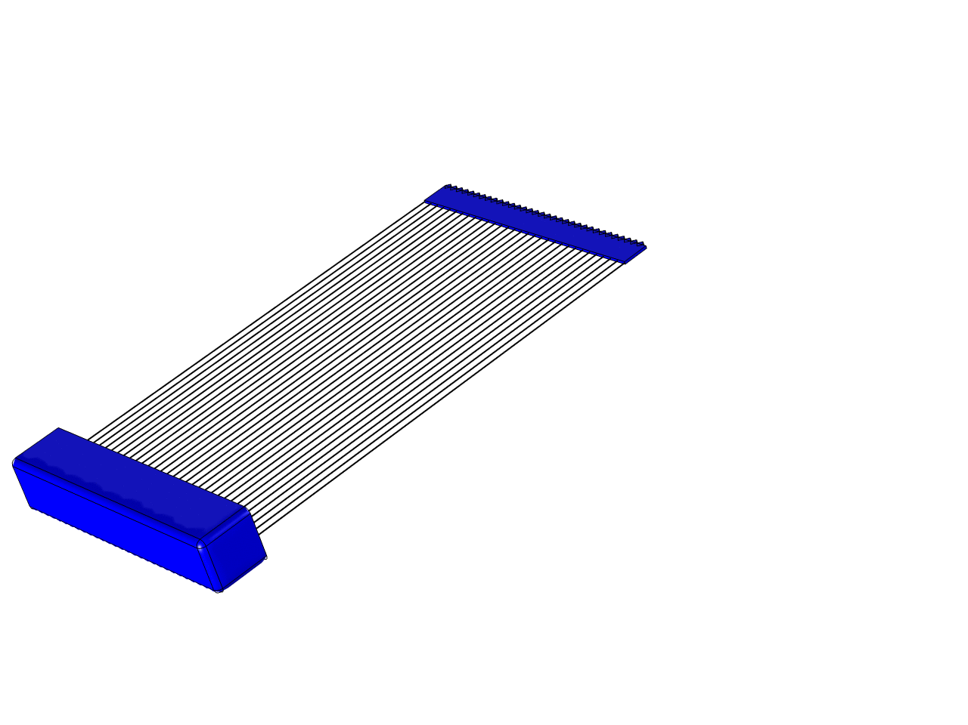

Slide 7
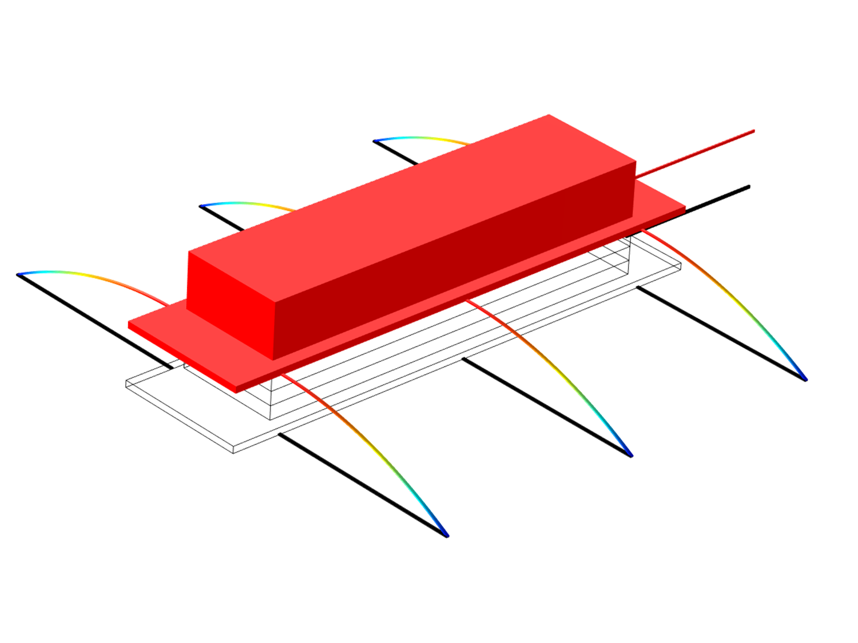

Slide 9
